Slide 1
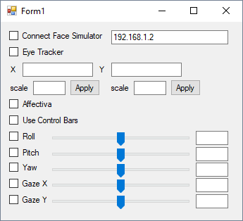
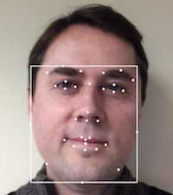
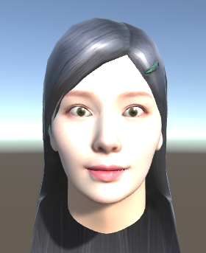
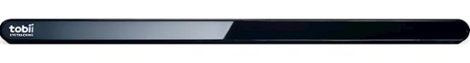
Overall Flow
Simulator
(Unity with C#)
Face Controller
(Visual C#)
Facial MoCap
(C#, Affectiva Lib)
16 expressions head orientation
eye position
16 expressions head orientation (landmarks position)
eye position
Tobii Eye Tracker

Slide 2
16 Expressions + Head orientation from Affectiva
1) Head orientation
2) Eye rotation (currently just the opposite direction of the head orientation)
3) Brow raise
4) Brow furrow
5) Eye closure
6) Eye lid tighten
7) Eye widen
8) Nose wrinkle
9) Smile
10) Dimpler
11) Lip corner depressor
12) Upper lip rase
13) Chin raise
14) Lip pucker
15) Mouse open
16) Jaw drop
17) Cheek raise
(Here you can find the references to the expressions.: https://developer.affectiva.com/metrics/)
Affectiva provides 21 expressions but I’ve been using 16 expressions.

Slide 3
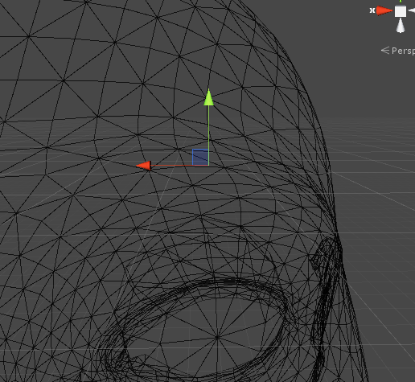
Processes in Unity
a control point
find linked vertices
and calculate weights based on distances
Avatar’s mesh vertices update
v1
v2
…
…
Expressions (from Affectiva)
Eye brows raised (0-100)
Bye brows furrow (0-100)
…
…
Control Points (CPs)
Right Brow Center
Outer Right Brow
Inner Right Brow
…
Weights associate with a CP
weight for i-th linked vertex
weight for (i+1)-th linked vertex
…
Weights associate with a CP
weight for i-th linked vertex
weight for (i+1)-th linked vertex
…

Slide 4
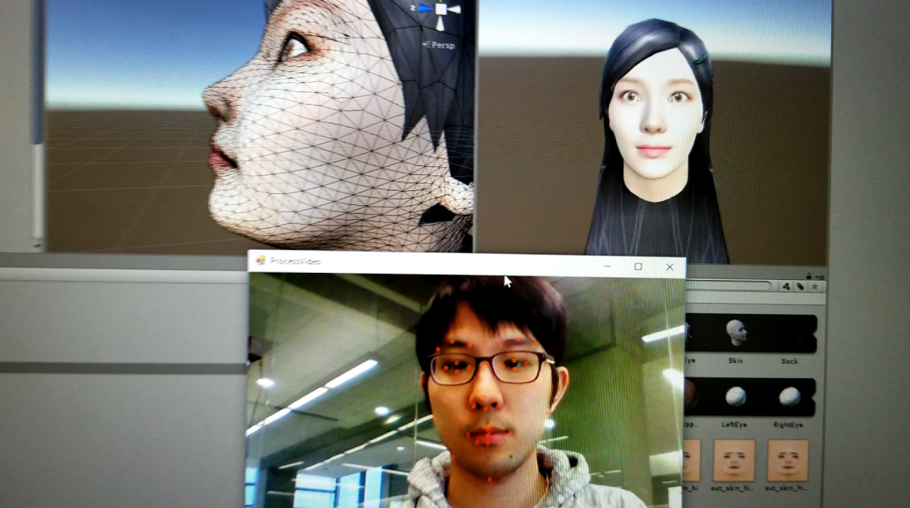
Demo (Facial Expressions)

Slide 5
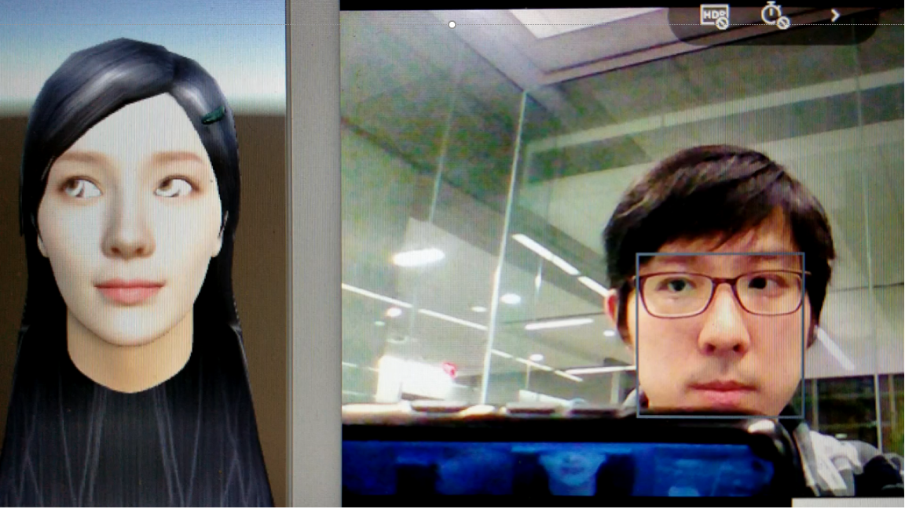
Demo Eye Gaze)

Slide 6
Further Work
Simulator
(Unity with C#)
Face Controller
(Visual C#)
Facial MoCap
(C#, Affectiva Lib)
data
data
16 expressions head orientation
eye position
16 expressions head orientation (landmarks position)
More characters
eye position
Add control bars for expressions
Tobii Eye Tracker

Slide 7
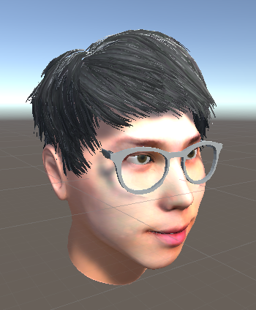
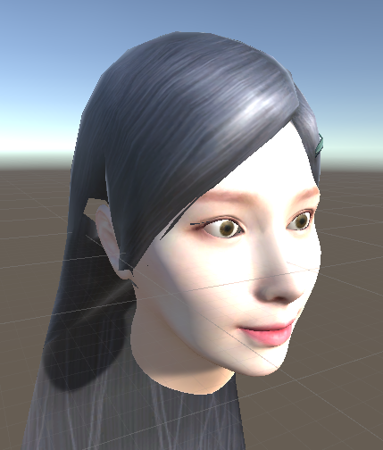
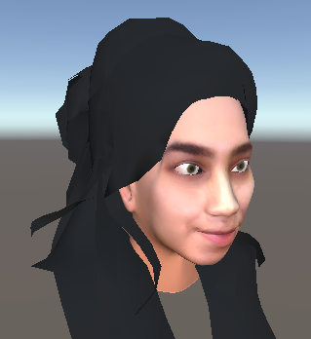
More Characters

